Slide 1






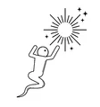




















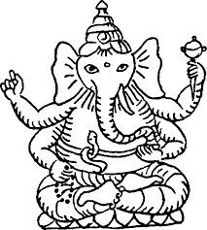














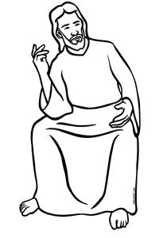




Religion and Worldviews Learning Journey
Religion, Crime and Punishment
Religion, and Life
College
Work
Year
11
Religion, Relationships and Sexuality
Alternative Religions
Do we need to prove God’s existence?
Is religion a power of peace or cause of conflict?
Year
10
Should happiness be the purpose of life?
Why is there suffering?
What difference does it make to believe in Buddhism?
Does religion help people to be good?
Is death the end?
What difference does it make to believe in Hinduism?
Year
9
Does living biblically mean obeying the whole Bible?
What difference does it make to believe in Christianity?
Year
8
Year
8
What is good and challenging about being a religious teenager?
Should religious buildings be sold to feed the starving?
How can people express through music and art?
Year
8
What difference does it make to believe in Sikhism?
What difference does it make to believe in Islam?
What is so radical about Jesus?
Year
7
Year
7
Year
7

