Slide 1

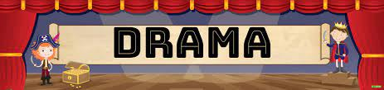





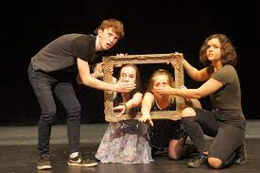

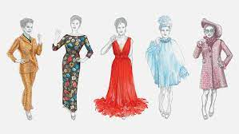

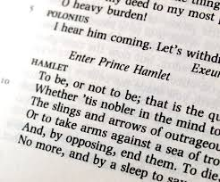
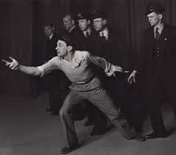




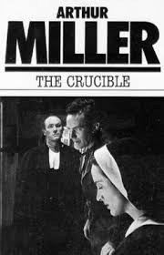
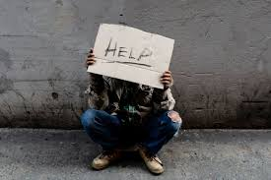






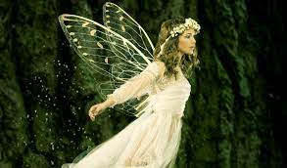

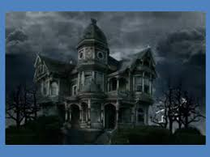

HT3: Responding to a Brief
HT4: Responding to a Brief
HT5: Responding to a Brief
YEAR
HT2: Developing Skills and Techniques in the Performing Arts
HT1: Developing Skills and Techniques in the Performing Arts
11
HT4: Exploring the Performing Arts
HT5: Developing Skills and Techniques in the Performing Arts
HT6: Developing Skills and Techniques in the Performing Arts
YEAR
10
HT3: Exploring the Performing Arts
HT2: Exploring the Performing Arts
HT1: Exploring the Performing Arts
HT4: Theory and Hamlett
HT5: Noughts and Crosses
HT6: Noughts and Crosses
YEAR
9
HT3: The Crucible
HT2: Sweeny Todd
HT1: Devising - Homelessness
HT4: Theory and Romeo and Juliet
HT5: The Terrible Fate of Humpty Dumpty
HT6: The Terrible Fate of Humpty Dumpty
YEAR
HT2: Melodrama and Pantomimes
8
HT3: Social Media
HT1: Inspirational People
HT4: Theory and Midsummer Night Dream
HT5: Charlie and the Chocolate Factory
HT6: Charlie and the Chocolate Factory
YEAR
HT3: Darkwood Manor
HT2: Evacuees
HT1: The Apothecary
7

